Slide 1

E-COMMERCE
DATA ANALYSIS & INSIGHTS

Slide 2
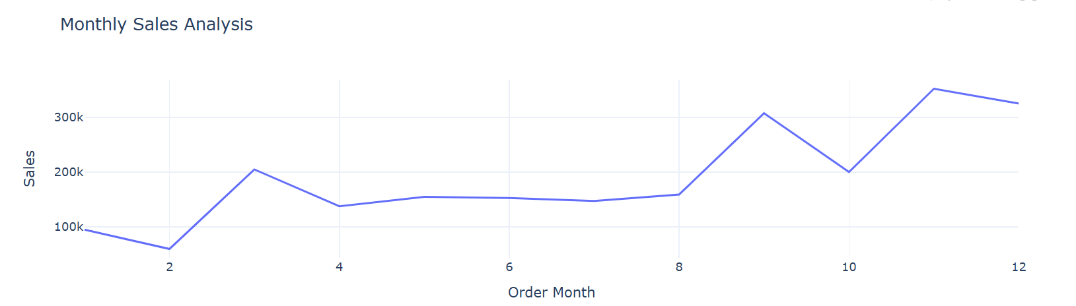
Monthly Sales Analysis
February (Month 2): Recorded the lowest sales of
the year (~$60k).
Likely impacted by fewer days and post-holiday slowdown.
March (Month 3): Significant rise in sales (~$200k+), a clear recovery from February.
April to August (Months 4–8): Sales remained relatively stable, fluctuating mildly between ~140kand 160k.
September (Month 9): Marked a sharp spike, crossing $300k in sales.
October (Month 10): Notable dip again, dropping back to around ~$200k.
November (Month 11): Highest sales month, peaking above $340k.
December (Month 12) : Slight decline compared to November, but still a strong closing to the year (~$320k).

Slide 3
INSIGHTS
Seasonal Impact: November clearly benefits from holiday and promotional events like Black Friday.
Post-Q1 Boost: March's jump could be due to fiscal-year endings or quarterly sales targets.
Stable Mid-Year: April to August shows consistent demand with no major fluctuations, ideal for operational planning.
Underperformance in February: Indicates potential for improvement — perhaps via promotions or campaigns.
High Potential in Q4: Q4 months (Sep–Dec) show strong momentum — should be the focus of marketing and inventory ramp-up.

Slide 4
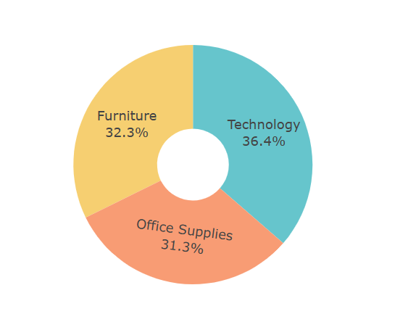
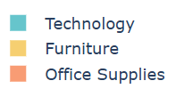
Sales By Category Analysis
Top Category: Technology
Accounts for 36.4% of total sales.
Strongest performing category
— includes high-value items like phones, machines, accessories, etc.
Likely drives the highest revenue per item.
Second: Furniture
Represents 32.3% of sales.
Consistently solid — includes items like chairs, tables, bookcases.
Reflects demand for workplace and home-office setups.
Third: Office Supplies
Makes up 31.3% of sales.
Includes lower-priced, high-volume items like binders, paper, labels, etc.
Even though it’s the smallest slice, it’s very close to Furniture — still an important contributor.

Slide 5
INSIGHTS
The sales are fairly evenly distributed across the three categories — no extreme imbalance.
Technology leads slightly, likely due to higher unit prices, even if volume is lower.
Furniture and Office Supplies combined form 63.6% — suggesting a strong foundational need in workplace essentials.

Slide 6
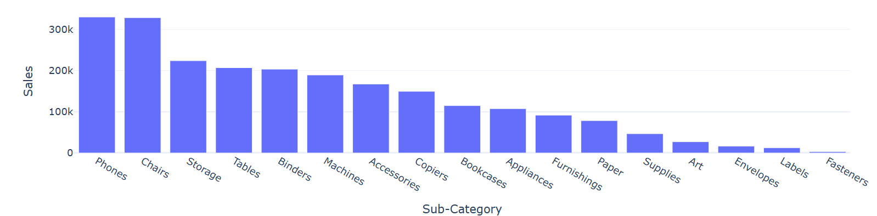
Sales by Sub-Category Analysis
Top Performers:
Phones and Chairs lead in sales, each generating
over $300k,indicating strong customer demand.
Storage, Tables, and Binders follow,
with sales around the $200k+ mark.
Mid-Range Performers:
Machines, Accessories, Copiers, and Bookcases have moderate sales between $100k–$200k.
These categories might offer room for sales growth with targeted strategies.
Low Performers:
Fasteners, Labels, Envelopes, and Art are at the bottom, each with sales below $50k.
These may represent niche products, limited demand, or under-marketed areas.

Slide 7
INSIGHTS
Phones and Chairs are the most lucrative sub-categories — consider increasing inventory, promotions, or bundling options for these.
Low-performing sub-categories could either be phased out or repositioned based on profitability, strategic value, or customer feedback.
Mid-range categories like Machines and Accessories are worth investigating for untapped potential or optimization.

Slide 8
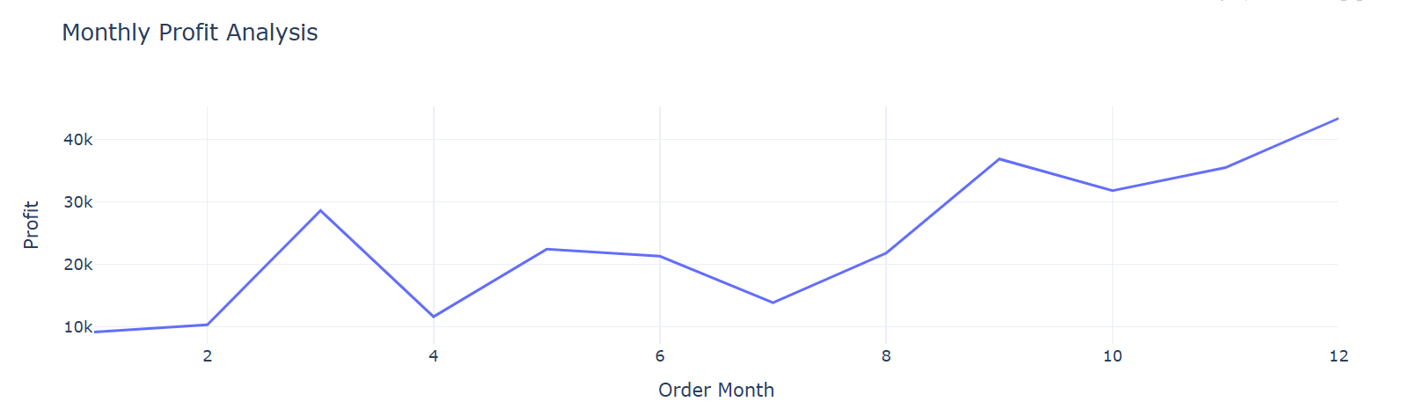
Monthly Profit Analysis
January–February (Months 1–2): Low profits (~$9k–$10k), relatively flat start to the year.
March (Month 3): Significant increase to ~$28k, the first major spike in profit.
April (Month 4): Drop to ~13k, a notable dip following March’s high.
May–June (Months 5–6): Gradual recovery with profits around $22k, but still below March.
July (Month 7): Dips again to ~$14k, lowest since February.
August–October (Months 8–10): Profits steadily increase from ~$22k to ~$31k, showing growth momentum.
November (Month 11): Slight uptick (~$35k), maintaining strong performance.
December (Month 12):Peaks at ~$43k, the highest profit month of the year.

Slide 9
Insights
December is most profitable — likely due to year-end purchases, gifting season, or bulk business buying.
March shows potential — despite being early in the year, it outperforms several months; this may indicate specific seasonal campaigns or tax-year effects.
Mid-year volatility (Apr–Jul) — inconsistent profits could be a result of operational costs, discount strategies, or market fluctuations.
Steady growth in Q4 — consistent increase in profits from August to December reflects effective strategies or peak demand seasons.

Slide 10
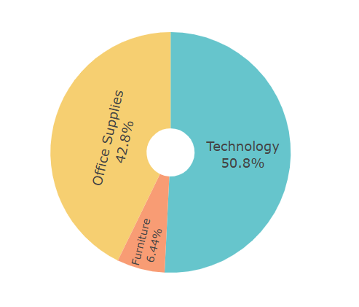
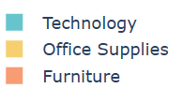
Profit Analysis Category
Technology: 50.8% of total profit
Contributes more than half of overall profitability,
indicating high-margin products or strong sales volume.
Office Supplies:42.8% of total profit
A significant portion, showing that even with generally lower unit prices,
this category remains profitable—likely due to high volume or operational efficiency.
Furniture: 6.44% of total profit
Lowest profit contribution despite having a decent sales percentage (~32.3% in your earlier chart).
This suggests either lower margins or higher costs associated with furniture.

Slide 11
Insights
Technology is the profit driver: Focus on expanding this category, offering premium tech products, or bundling to boost further.
Office Supplies show healthy margins: Potential for growth via bulk corporate deals or subscriptions.
Furniture underperforms in profit: Requires attention—either improve pricing strategy, reduce operational costs, or reconsider product mix.

Slide 12
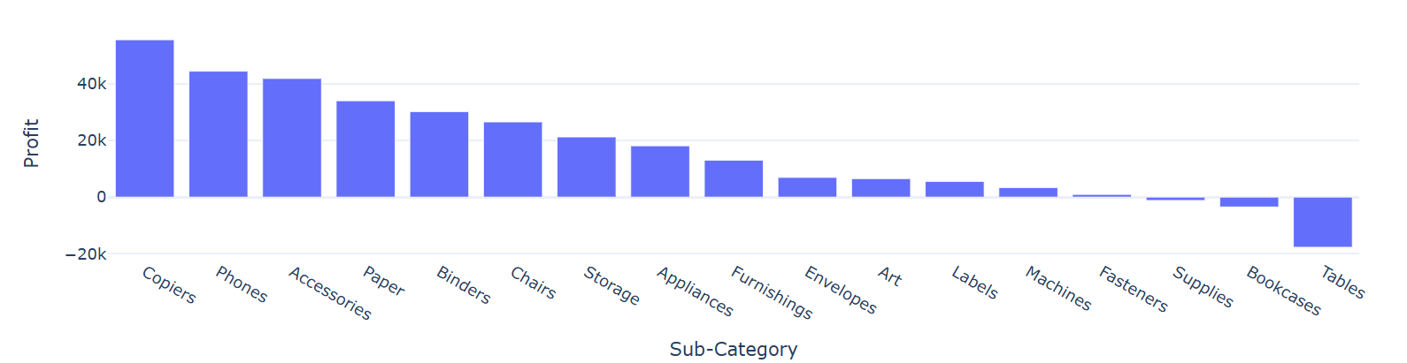
Profit Analysis by Sub-Category
Top 5 Most Profitable Sub-Categories:
Copiers – Highest profit contributor (~$50K+) :
Phones, Accessories, Paper, Binders
These items likely offer high margins or strong demand, particularly tech-related ones.
Moderately Profitable Sub-Categories:
Chairs, Storage, Appliances, Furnishings, Envelopes, Art
These contribute steadily to profits but may benefit from optimization or promotion strategies.
Low to Negative Profit Sub-Categories:
Fasteners, Supplies, Bookcases – Marginal profits or slight losses.
Tables – Most unprofitable, with a significant loss (~$20K). Indicates either high returns, high costs, or poor sales.

Slide 13
Insights
Tech and Office Essentials Drive Profits: Focus marketing and inventory investment on categories like Copiers, Phones, and Accessories.
Loss-making Furniture Items: Tables and Bookcases need immediate attention—consider cost reduction, redesign, or phasing out.
Niche Categories Like Art & Labels: May serve specific customer bases—evaluate if they’re strategically valuable despite low profits.

Slide 14
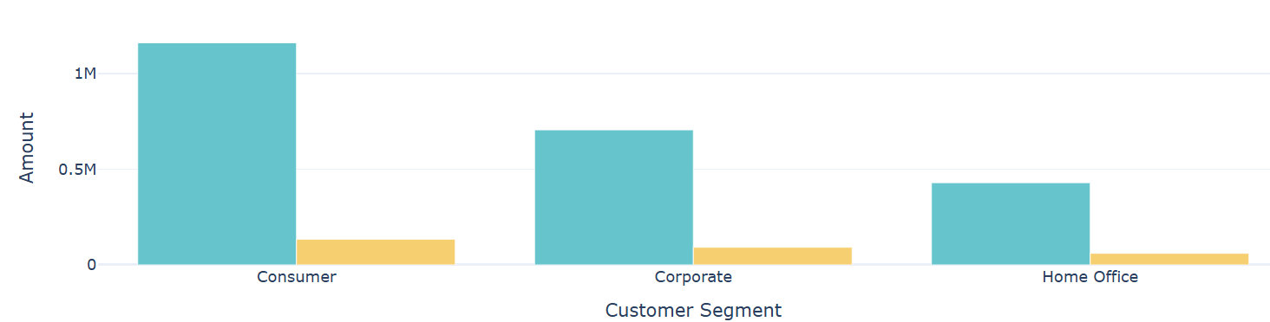

Sales & Profit Analysis by Customer Segment
Consumer Segment: Highest Sales: Over 1 million,
indicating strong demand.
Profit: Also the highest among all segments.
Implication: This segment is the main revenue and profit driver.
Corporate Segment: Moderate Sales: ~700K range.
Moderate Profit: Significantly lower than sales, suggesting lower margins or higher operational costs.
Home Office Segment: Lowest Sales and Profit: Least contribution to overall performance.
May indicate a niche audience or low-volume orders.

Slide 15
Insights
Consumer Segment is Key: Focus marketing, promotions, and personalized offers here to maximize returns.
Corporate Segment Needs Margin Optimization: Look into discounting policies, delivery costs, or bundled offers to improve profit margins.
Home Office Has Growth Potential: Explore targeted strategies (e.g., remote work solutions or small business kits) to boost engagement and revenue.

Slide 16
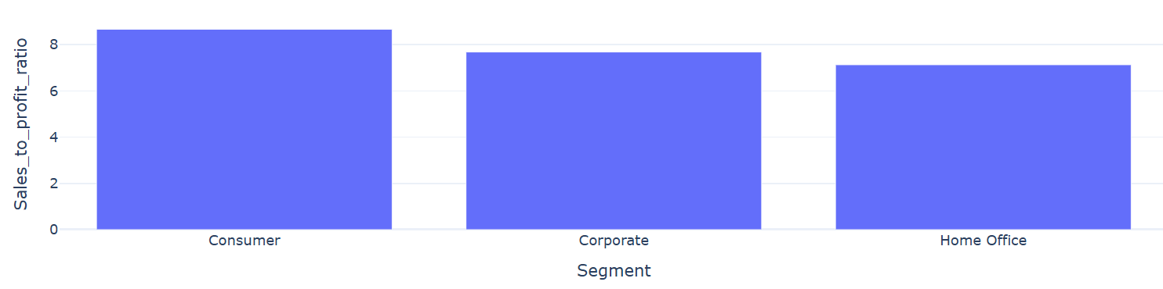
Sales to Profit Ratio Analysis
The Sales to Profit Ratio signifies how much sales revenue is generated for every unit of profit, indicating the efficiency of turning revenue into profit—a lower ratio means higher profitability.
Consumer has the highest ratio, slightly above 8.5.
Corporate comes next with a ratio around 7.7.
Home Office has the lowest ratio, approximately 7.1.

Slide 17
Insights
Consumer Segment is the Most Efficient:
The Consumer segment yields the most profit relative to sales. This suggests strong pricing power, lower cost structure, or high-volume sales leading to better margins.
Corporate Segment is Moderately Efficient:
While not as high as Consumer, the Corporate segment still maintains a healthy sales-to-profit ratio, indicating it is a strong contributor to profitability.
Home Office Segment Needs Attention:
The Home Office segment lags behind. This could indicate higher costs, lower profit margins, or pricing challenges.
May require optimization in operations, pricing strategies, or targeting more profitable customers.

